Slide 1
From Laboratory to Life, from Cell to Society
Global Health Team
WC2 2019

Slide 2
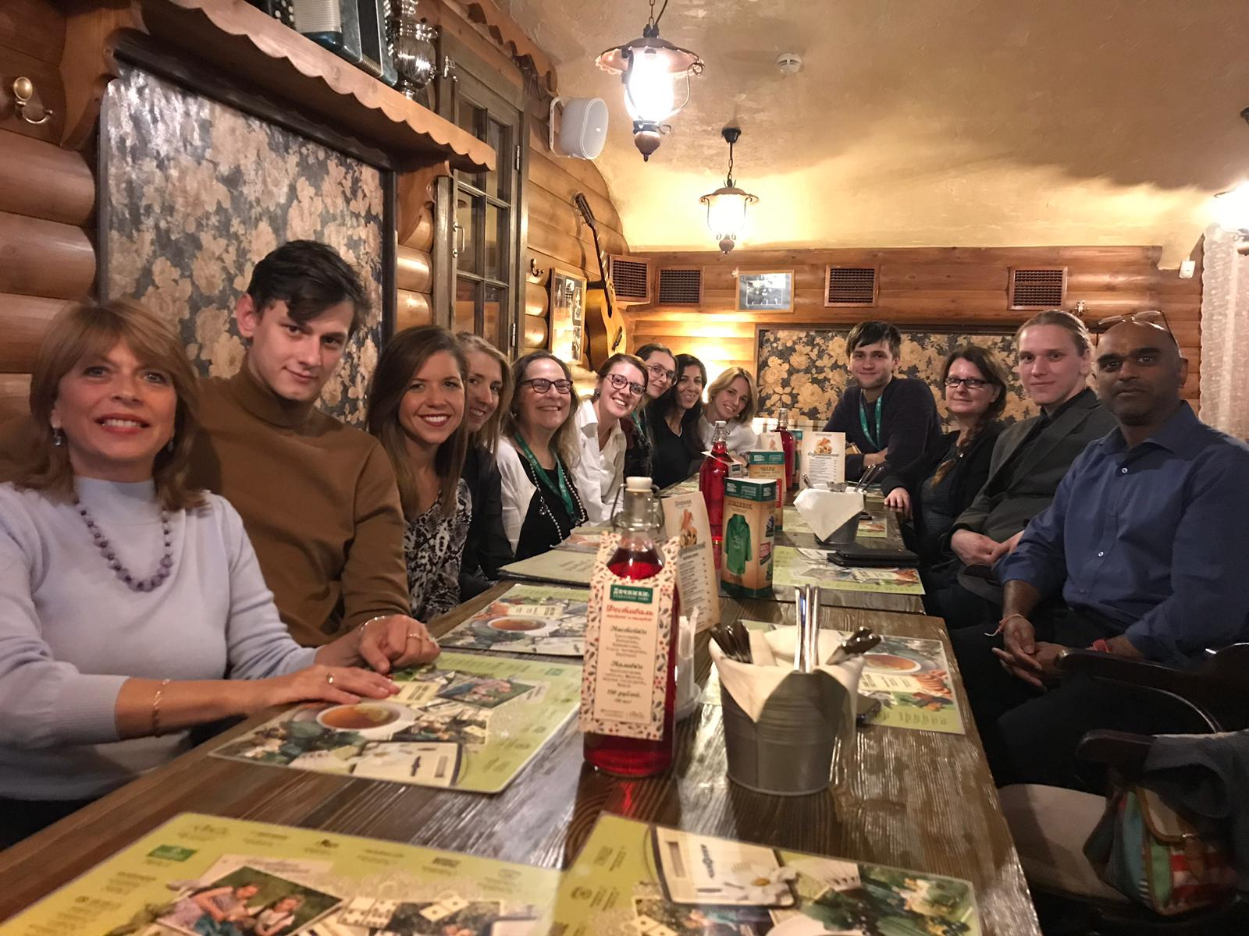
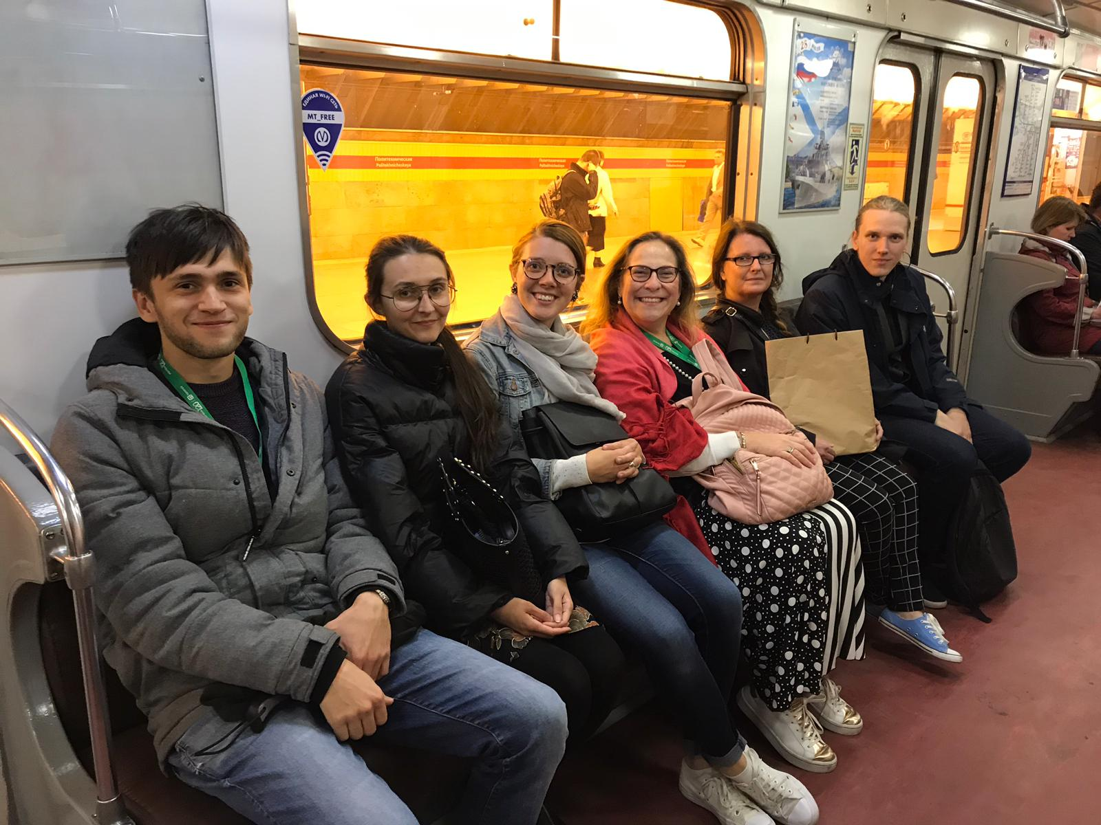
Introduction
Notes:
Ice breaker (Britt)
Everyone stand up:
- Sit if you have used an app to access health care
- Sit if you have used an app to manage a health condition
- Sit if you use some sort of wearable tech to track your health
- Have a seat if you have a smart phone
- Sit if you have a computer at home
Everyone stand up:
- Sit if you have used an app to access health care
- Sit if you have used an app to manage a health condition
- Sit if you use some sort of wearable tech to track your health
- Have a seat if you have a smart phone
- Sit if you have a computer at home
4 mins

Slide 3
Where we are from
Notes:
Ice breaker (Britt)
Everyone stand up:
- Sit if you have used an app to access health care
- Sit if you have used an app to manage a health condition
- Sit if you use some sort of wearable tech to track your health
- Have a seat if you have a smart phone
- Sit if you have a computer at home
Everyone stand up:
- Sit if you have used an app to access health care
- Sit if you have used an app to manage a health condition
- Sit if you use some sort of wearable tech to track your health
- Have a seat if you have a smart phone
- Sit if you have a computer at home
4 mins

Slide 4
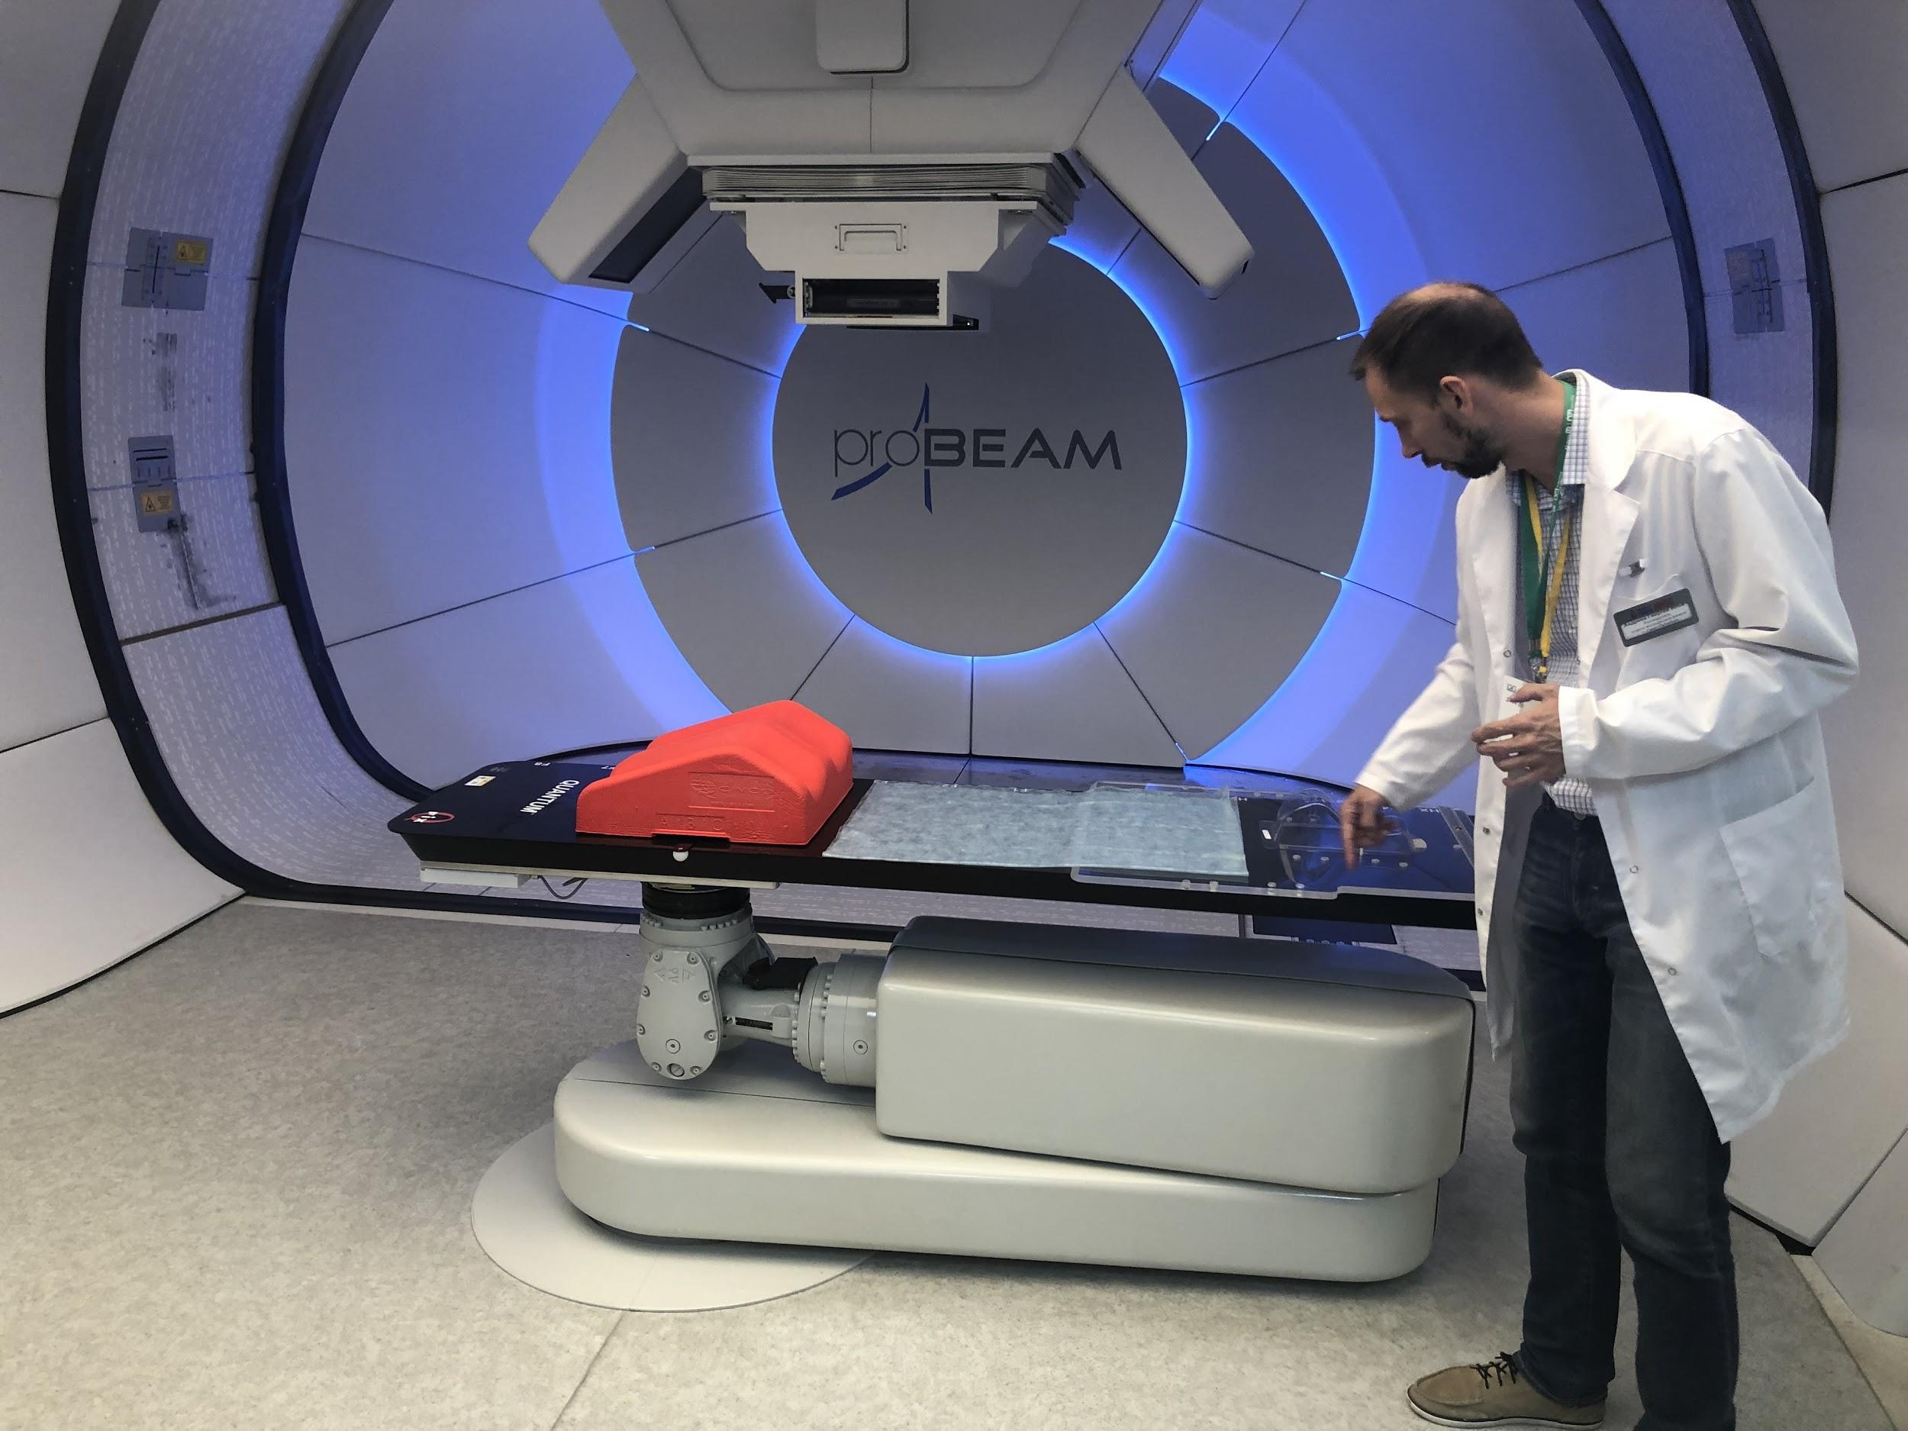
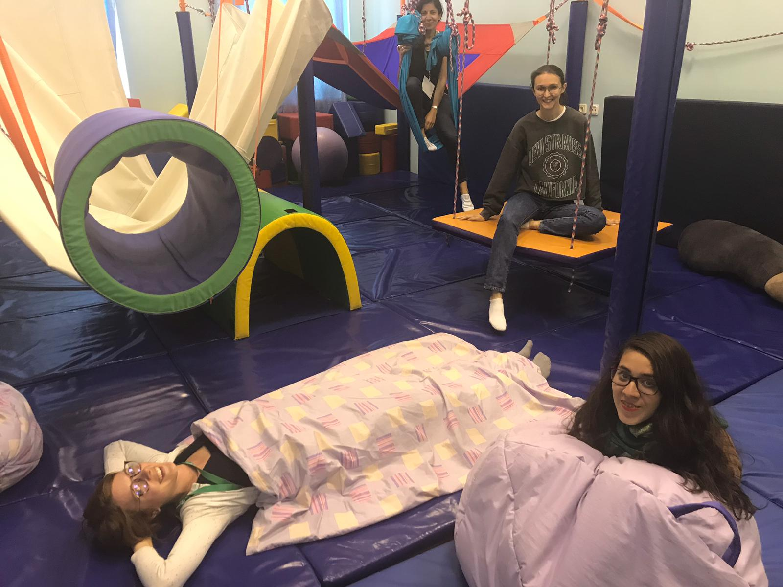
Global Health Club
Notes:
Ice breaker (Britt)
Everyone stand up:
- Sit if you have used an app to access health care
- Sit if you have used an app to manage a health condition
- Sit if you use some sort of wearable tech to track your health
- Have a seat if you have a smart phone
- Sit if you have a computer at home
Everyone stand up:
- Sit if you have used an app to access health care
- Sit if you have used an app to manage a health condition
- Sit if you use some sort of wearable tech to track your health
- Have a seat if you have a smart phone
- Sit if you have a computer at home
4 mins

Slide 5
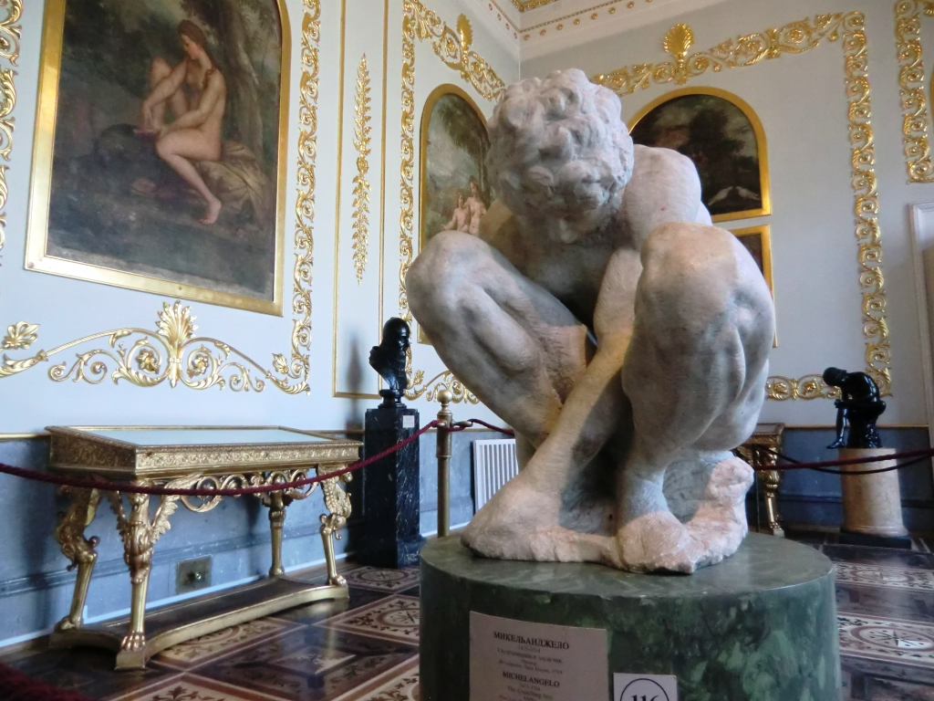
Ethics and Privacy
Michelangelo’s Crouching Boy, (1530-1534)
Notes:
From the plenary session, our group repeatedly circled back to the importance of privacy and the need for informed consent in how we use technology to collect and share data about our personal health information. [Emma] I was inspired by this sculpture of Michelango’s at the Hermitage which depicts the vulnerability of humanity. It is our responsibility to uphold ethics
· Lack of frameworks to answer legal issues [Rahna]
· Ex. Something goes wrong, who is responsible?

Slide 6
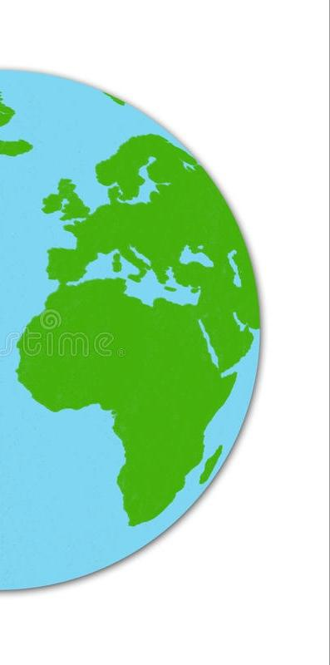
Accessibility
50%
Lack of access to essential health care
57%
Uses internet

Slide 7
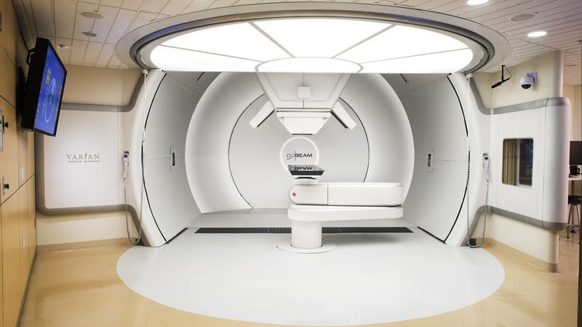
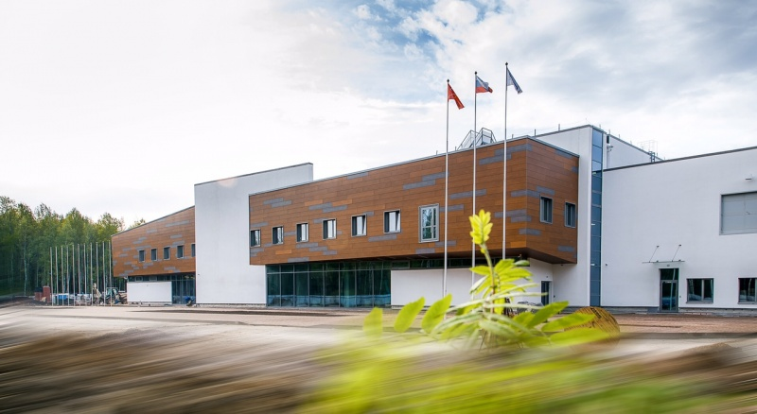
Expensive Technology
Technology development necessary for healthcare
Requires large financial investment from governments/non-governments

Slide 8
Acceptability
It is important to understand that the theory is about what we believe or what we perceive the technology to be.
The perception may change depending on age and gender Since we are different
Technology acceptance model:
Perceived usefulness
Perceived ease of use
Limitations:
Education and training
Technical and program support
Stable and sustainable
Perceived usefulness
Attitude toward using
Behavioral intention to use
External variables
Actual system use
Perceived ease of use

Slide 9
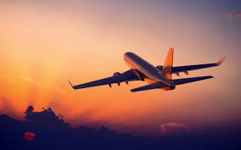
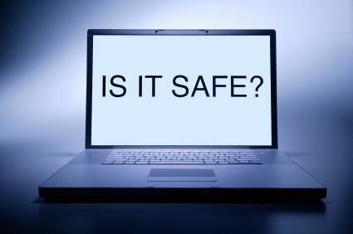
Data Infrastructure
We need to create a trusted system for managing private data
When you travel by plane you trust pilots, engineers, air traffic controllers etc. Otherwise you won’t use it

Slide 10
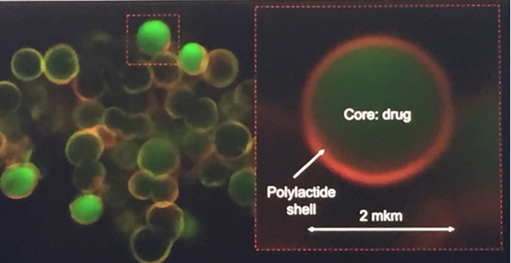
Reflections
Practical applications - learnings
Existing technology in health
Emerging technology
Telehealth
Key challenges
Acceptability
Accessibility

Slide 11
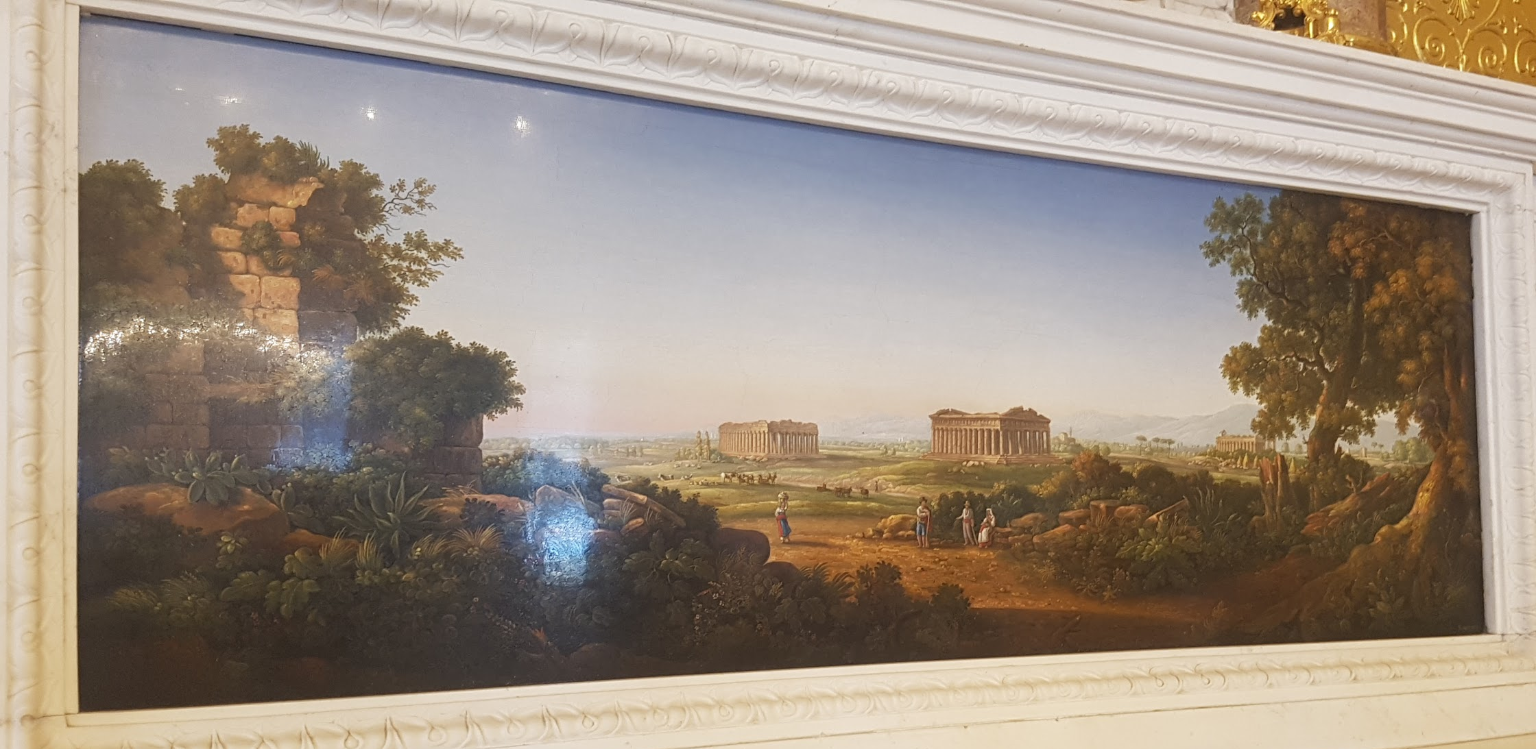
Conclusion
Mosaic art, Hermitage Museum
Notes:
What we reflected on this week is every stage, from development to the patient care is important. We are a group which represents the continuum of this [Emma]
What has been unique about our group, what being at St. Petersburg with WC2 has allowed us to do - what it has meant to me as a nurse learning what it means to see every level and the careers and years worth of work which goes into the vaccines I give. Sure to be exciting what will come out of WC2 next year

Slide 12
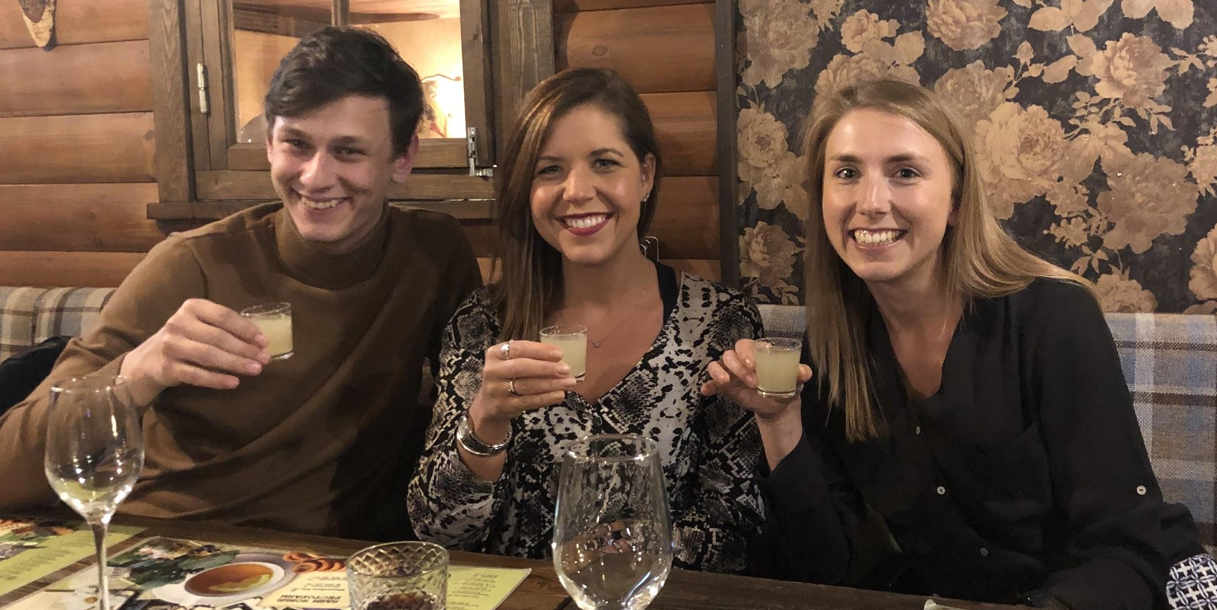
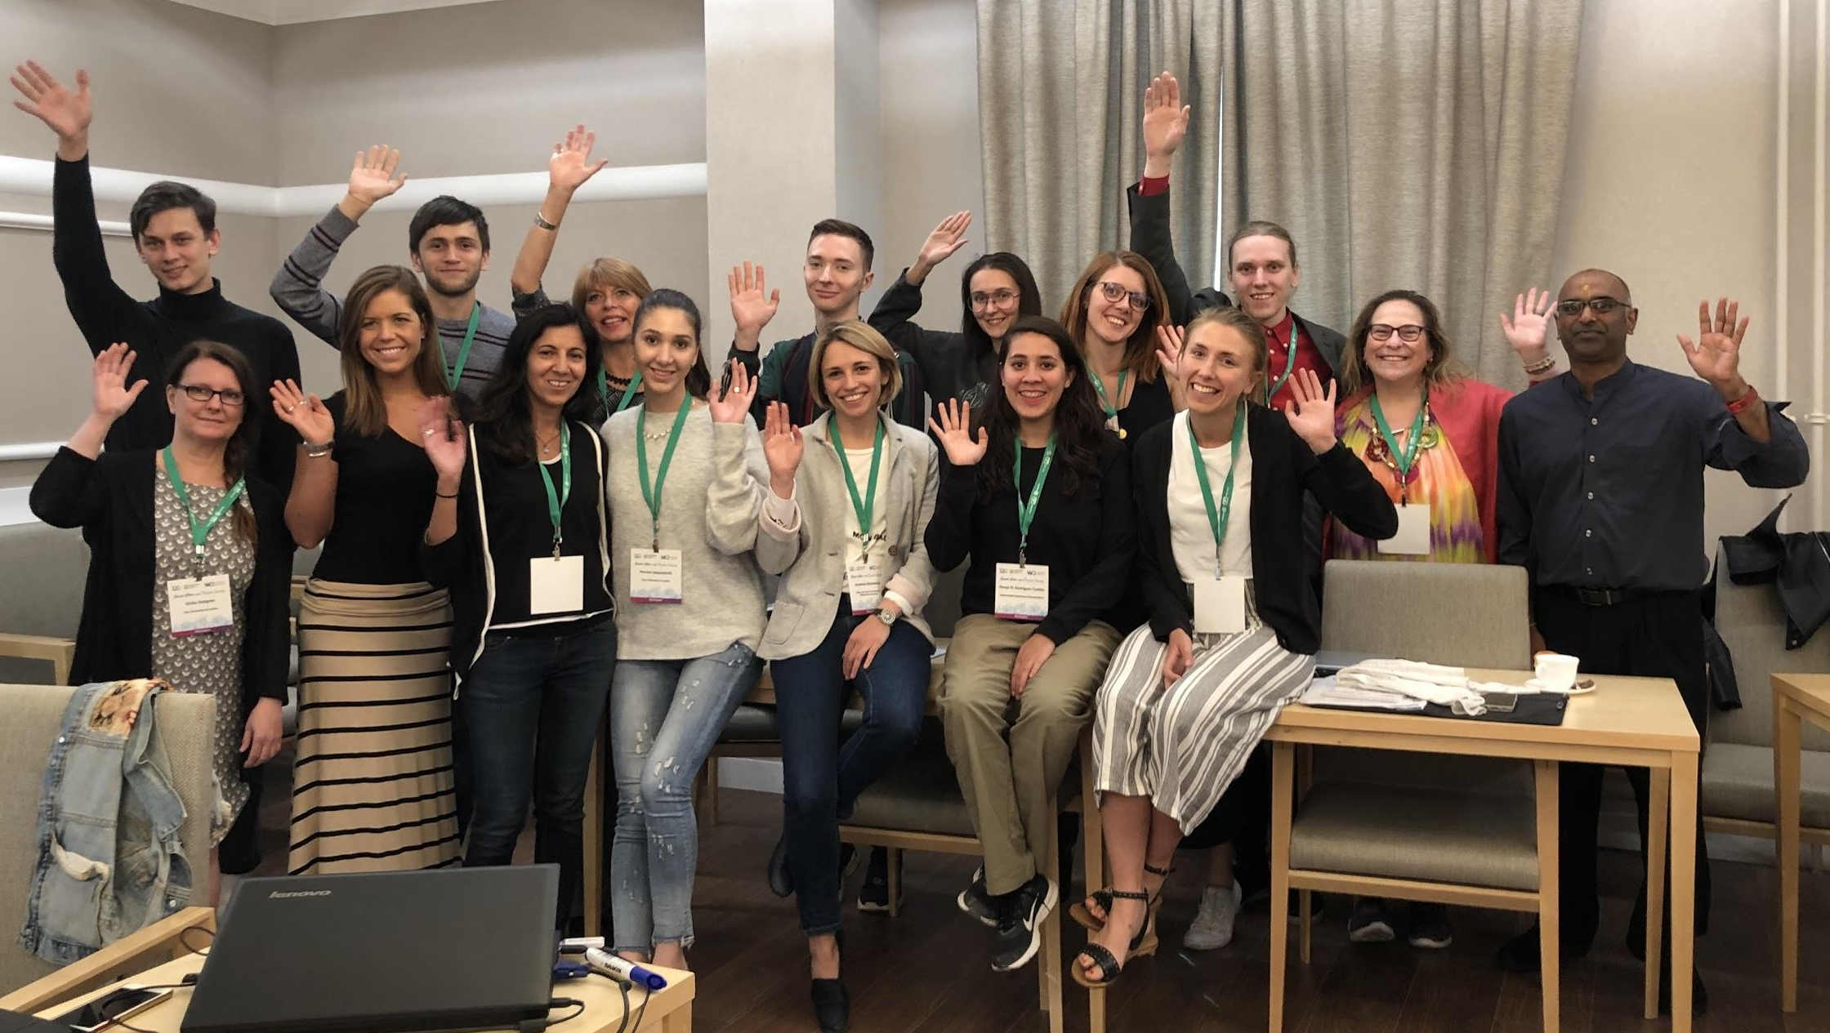
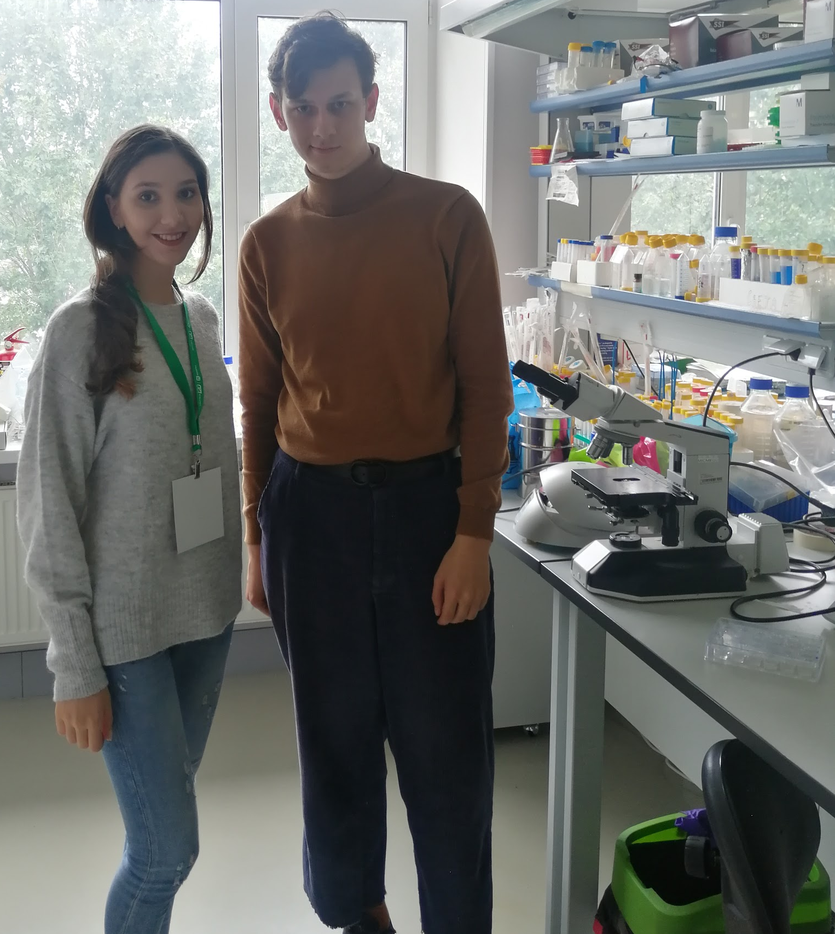
Thank you!

